Slide 1
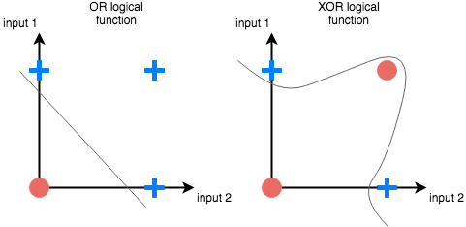
The XOR Problem
[source]
Notes:
This simple problem has an important history in ML.
Marvin Minsky wrote a paper in 1969 about the shortcomings of the perceptron (a simple variant of logistic regression) that led to growing disillusionment with the field… and the AI winter that lasted into the 1990s.

Slide 2
Logical Operators
NOT
x | y
0 | 1
1 | 0
Notes:
truth tables

Slide 3
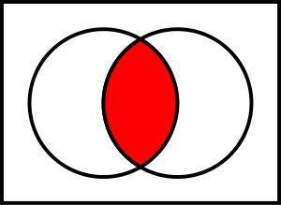
Logical Operators
NOT
AND
x | y
0 | 1
1 | 0
x₁ | x₂ | y
0 | 0 | 0
0 | 1 | 0
1 | 0 | 0
1 | 1 | 1

Slide 4
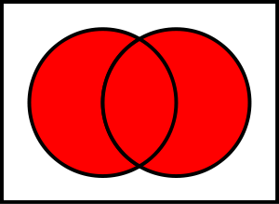
Logical Operators
NOT
AND
OR
x | y
0 | 1
1 | 0
x₁ | x₂ | y
0 | 0 | 0
0 | 1 | 0
1 | 0 | 0
1 | 1 | 1
x₁ | x₂ | y
0 | 0 | 0
0 | 1 | 1
1 | 0 | 1
1 | 1 | 1

Slide 5
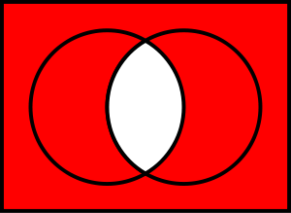
Logical Operators
NOT
AND
OR
NAND
x | y
0 | 1
1 | 0
x₁ | x₂ | y
0 | 0 | 0
0 | 1 | 0
1 | 0 | 0
1 | 1 | 1
x₁ | x₂ | y
0 | 0 | 0
0 | 1 | 1
1 | 0 | 1
1 | 1 | 1
x₁ | x₂ | y
0 | 0 | 1
0 | 1 | 1
1 | 0 | 1
1 | 1 | 0

Slide 6
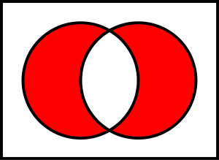
Logical Operators
NOT
AND
OR
NAND
XOR
x | y
0 | 1
1 | 0
x₁ | x₂ | y
0 | 0 | 0
0 | 1 | 0
1 | 0 | 0
1 | 1 | 1
x₁ | x₂ | y
0 | 0 | 0
0 | 1 | 1
1 | 0 | 1
1 | 1 | 1
x₁ | x₂ | y
0 | 0 | 1
0 | 1 | 1
1 | 0 | 1
1 | 1 | 0
x₁ | x₂ | y
0 | 0 | 0
0 | 1 | 1
1 | 0 | 1
1 | 1 | 0
Notes:
Actually 16 total functions on 2 binary inputs.
We can design simple circuits that compute these functions, which can be combined to form more complex functions.
For example, a 1-bit adder can be built from AND, OR, and XOR functions.

Slide 7
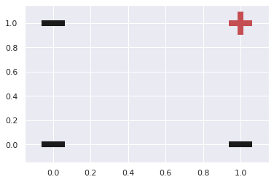
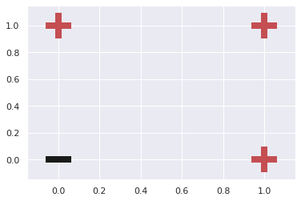
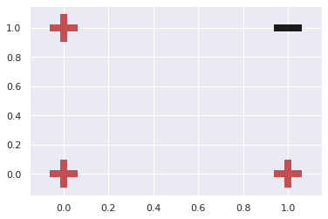
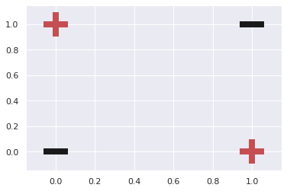
Linearly Separable Operators
AND
OR
NAND
XOR
Notes:
Ok why am I telling you all this? Well Minsky wanted to know if we could use the techniques of ML to learn these basic circuits instead of designing them by hand.
We can think of each operator as a binary classifier.
And notice that unlike the others, XOR is not linearly separable.

Slide 8
Constructing XOR
x₁ | x₂ | h₁=OR(x₁,x₂) | h₂=NAND(x₁,x₂) | y=AND(h₁,h₂)
0 | 0 | 0 | 1 | 0
0 | 1 | 1 | 1 | 1
1 | 0 | 1 | 1 | 1
1 | 1 | 1 | 0 | 0
Notes:
However, we can construct an XOR function from the linear functions as follows.

Slide 9
Constructing XOR
x₁ | x₂ | h₁=OR(x₁,x₂) | h₂=NAND(x₁,x₂) | y=AND(h₁,h₂)
0 | 0 | 0 | 1 | 0
0 | 1 | 1 | 1 | 1
1 | 0 | 1 | 1 | 1
1 | 1 | 1 | 0 | 0
Input
Hidden
Output
x₁
h₁
y₁
x₂
h₂
Notes:
Using our network diagrams, here’s what this function would look like

Slide 10
Learning XOR
Data
X = np.array([[0, 0], [0, 1],
[1, 0], [1, 1]])
Y = np.array([0, 1,
1, 0])
Notes:
Ok let’s move this whole discussion into python and make our definition of neural networks concrete

Slide 11
Learning XOR
Data
X = np.array([[0, 0], [0, 1],
[1, 0], [1, 1]])
Y = np.array([0, 1,
1, 0])
Model
def build_xor_model(hidden_layer_sizes=[]):
model = keras.Sequential()
for hidden_layer_size in hidden_layer_sizes:
model.add(keras.layers.Dense(units=hidden_layer_size,
activation='tanh'))
model.add(keras.layers.Dense(units=1, activation='sigmoid'))
model.compile(loss='binary_crossentropy',
optimizer=keras.optimizers.SGD(learning_rate=1))
return model

Slide 12
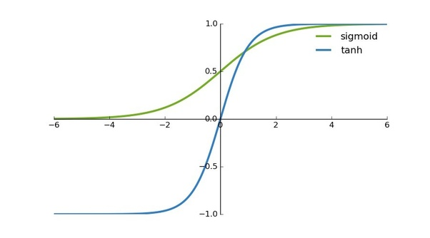
Learning XOR
Data
X = np.array([[0, 0], [0, 1],
[1, 0], [1, 1]])
Y = np.array([0, 1,
1, 0])
Model
def build_xor_model(hidden_layer_sizes=[]):
model = keras.Sequential()
for hidden_layer_size in hidden_layer_sizes:
model.add(keras.layers.Dense(units=hidden_layer_size,
activation='tanh'))
model.add(keras.layers.Dense(units=1, activation='sigmoid'))
model.compile(loss='binary_crossentropy',
optimizer=keras.optimizers.SGD(learning_rate=1))
return model
Notes:
sigm: 1/(1+e^-x)
tanh: 2/(1+e^-2x) - 1

Slide 13
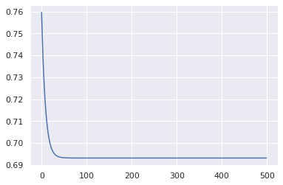
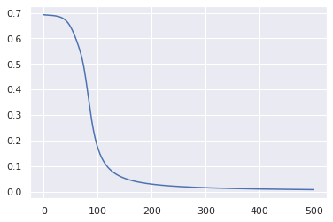
Learning XOR
Linear
xor_model = build_xor_model(hidden_layer_sizes=[])
history = xor_model.fit(x = X, y = Y, epochs=500,
batch_size=4)
losses = history.history['loss']
plt.plot(losses)
1 Hidden Layer
xor_model = build_xor_model(hidden_layer_sizes=[2])
history = xor_model.fit(x = X, y = Y, epochs=500,
batch_size=4)
losses = history.history['loss']
plt.plot(losses)

Slide 14
Learned XOR Model
Input
Hidden
Output
b₁
b₃
x₁
w⁰₁₁
h₁
w¹₁₁
w⁰₂₁
y₁
w⁰₁₂
w¹₂₁
x₂
w⁰₂₂
h₂
b₂
Notes:
h1 = [x1, x2] * [w11, w21] + b1 -> tanh()
h2 = [x1, x2] * [w12, w22] + b2 -> tanh()
y = [h1, h2] * [w11, w21] + b3 -> sigmoid()

Slide 15
Learned XOR Model
Input
Hidden
Output
1.5
5
x₁
-3
h₁
3
-5
y₁
3
-5
x₂
-3
h₂
1.5
Notes:
h1 = [x1, x2] * [-3, 3] + 1.5 -> tanh(.)
h2 = [x1, x2] * [3, -3] + 1.5 -> tanh(.)
y = [h1, h2] * [-5, -5] + 5 -> sigmoid(.)

Slide 16
Learned XOR Model
Input
Hidden
Output
1.5
5
x₁
-3
h₁
3
-5
x₁ | x₂ | h₁ | h₂ | y
0 | 0 | 1 | 1 | 0
0 | 1 | 1 | 0 | 1
1 | 0 | 0 | 1 | 1
1 | 1 | 1 | 1 | 0
y₁
3
-5
x₂
-3
h₂
1.5
Notes:
h1 = [x1, x2] * [-3, 3] + 1.5 -> tanh(.)
h2 = [x1, x2] * [3, -3] + 1.5 -> tanh(.)
y = [h1, h2] * [-5, -5] + 5 -> sigmoid(.)
h1 = implication
h2 = converse
y = nand

Slide 17
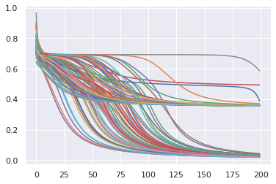
Initialization
Training 100 models from different initializations show a range of loss patterns

Slide 18
Initialization
Training 100 models from different initializations show a range of loss patterns
Some fail to reach 0 loss
Some seem to get stuck for a while
Suggests a pretty complex loss function (in 9 dimensions)

Slide 19
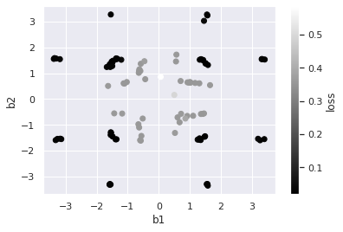
Initialization
Models learn a range of different solutions!

Slide 20
Initialization
Models learn a range of different solutions!
One of them corresponds to what we constructed earlier
Note that the loss surface (in 9-D) has no global minimum

Slide 21
Lessons of XOR
XOR function has no linear model solution
Can compose simple (linear) functions to solve it
A neural network can learn a solution
Parameter initialization can be important
Complex loss landscape with many possible solutions

Slide 22
The XOR Problem
Notes:
Q: Our neural network solution to the XOR problem had how many parameters?
A: 9

Slide 23
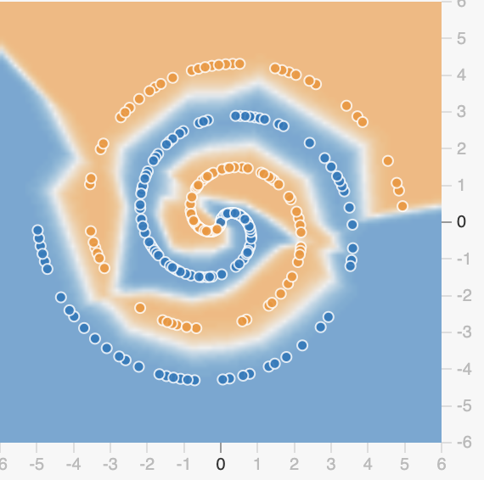
Beyond XOR
[Tensorflow Playground]
Notes:
Screen capture via tensorflow playground (no slides)

Slide 24
Beyond XOR
Notes:
Q: [T/F] With inputs X₁ and X₂, the neurons in the first layer can only learn diagonal lines.
A: T

Slide 25
Back-Propagation I
Error
x₁
h₁
y₁
x₂
h₂
Prediction
Notes:
Remember when we talked about linear regression, we took the derivative of the loss function and showed how to update all the parameters in gradient descent.
We basically want to go through the same process, but now for neural networks, where the functional form for the model is more complex.
I’ve sat through a number of these derivations for neural networks and the problem is that the notation gets very difficult very quickly.
So I’m going to focus on giving you as much useful intuition as possible so that if you do choose to read/watch a full derivation, it will go more smoothly.

Slide 26
Gradient Descent
Make predictions
x₁
h₁
y₁
x₂
h₂
Prediction

Slide 27
Gradient Descent
Make predictions
Compute the loss
x₁
h₁
y₁
x₂
h₂
Prediction

Slide 28
Gradient Descent
Make predictions
Compute the loss
Compute gradient of the loss:
How is each parameter implicated in the loss?
Error
x₁
h₁
y₁
x₂
h₂
Prediction

Slide 29
Gradient Descent
Make predictions
Compute the loss
Compute gradient of the loss:
How is each parameter implicated in the loss?
How to compute gradients with more than 1 layer?
Error
x₁
h₁
y₁
x₂
h₂
Prediction

Slide 30
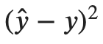
Gradient Descent
b₁
b₃
x₁
w⁰₁₁
h₁
w¹₁₁
w⁰₂₁
y₁
w⁰₁₂
w¹₂₁
x₂
w⁰₂₂
h₂
b₂

Slide 31
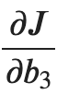
Gradient Descent
b₁
b₃
x₁
w⁰₁₁
h₁
w¹₁₁
w⁰₂₁
y₁
w⁰₁₂
w¹₂₁
x₂
w⁰₂₂
h₂
b₂

Slide 32
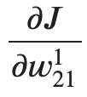
Gradient Descent
b₁
b₃
x₁
w⁰₁₁
h₁
w¹₁₁
w⁰₂₁
y₁
w⁰₁₂
w¹₂₁
x₂
w⁰₂₂
h₂
b₂

Slide 33
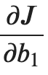
Gradient Descent
b₁
b₃
x₁
w⁰₁₁
h₁
w¹₁₁
w⁰₂₁
y₁
w⁰₁₂
w¹₂₁
x₂
w⁰₂₂
h₂
b₂

Slide 34
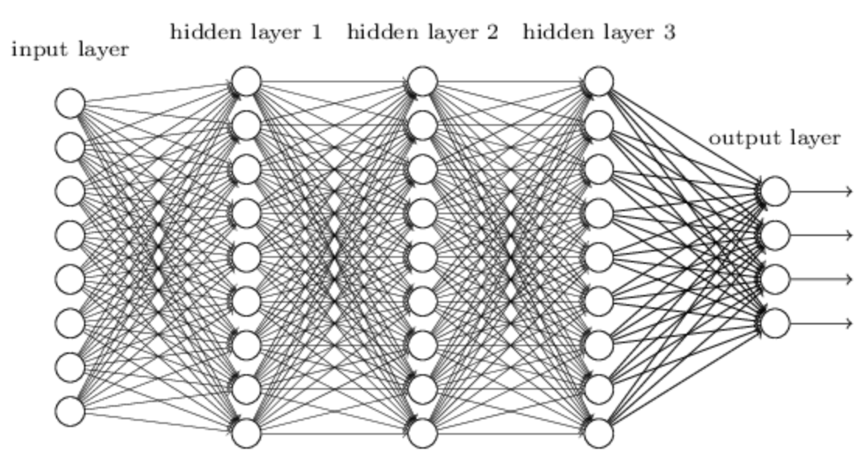
Small Changes
A small change to any parameter in a neural network should yield a small change in the output.
Notes:
All of the math in gradient descent and all of the design of neural network functions boils down to this one idea.
In ML, at least as we know it today, we learn by making small changes to parameters that gradually improve the output predictions.
So we want to set things up so that this works, and so that it’s straightforward to figure out what small changes to make.

Slide 35
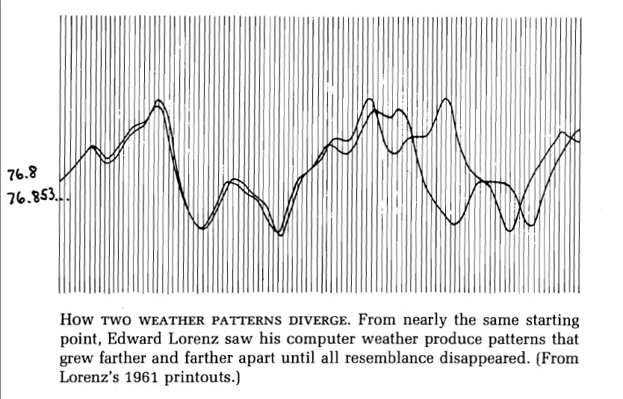
Chaos
Chaotic systems like weather tend to violate the small changes requirement
Notes:
also: butterfly effect (Lorenz)

Slide 36
Non-Chaotic Behavior
Limited non-linear functions
Notes:
How do our neural networks try to ensure non-chaotic behavior?

Slide 37
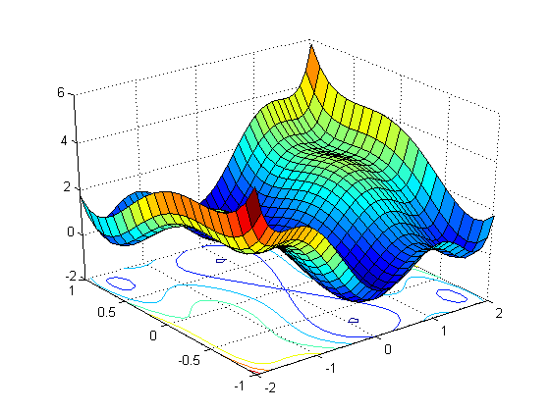
Non-Chaotic Behavior
Limited non-linear functions
Differentiable (smooth) loss

Slide 38
Non-Chaotic Behavior
Limited non-linear functions
Differentiable (smooth) loss
Each unit is a function of units in the previous layer
x₁
h₁
y₁
x₂
h₂

Slide 39
Back-Propagation I
Notes:
Q: [T/F] Computing the gradient of the loss in a neural network involves a partial derivative for just the parameters in the last layer.
A: F

Slide 40
Back-Propagation II
Error
x₁
h₁
y₁
x₂
h₂
Prediction

Slide 41
A Bad Training Algorithm
Try increasing/decreasing b₁ by a small amount and observe the change in the predicted value of y
Update b₁ so that the predicted y is closer to the true y
Repeat this process for all parameters
b₁
b₃
x₁
w⁰₁₁
h₁
w¹₁₁
w⁰₂₁
y₁
w⁰₁₂
w¹₂₁
x₂
w⁰₂₂
h₂
b₂
Notes:
Inefficient! What if we have millions of parameters? Need to do forward pass millions of times.
We want to optimize/adjust all parameters together.

Slide 42
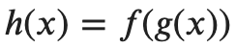
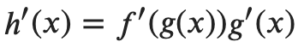
Chain Rule
Suppose you have a composite function:
and both f and g are differentiable functions.
Then the chain rule says that the derivative of h is the following product:

Slide 43
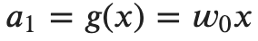
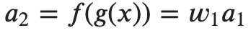
Neural Networks are Composite Functions
x
w₀
a₁
w₁
a₂

Slide 44
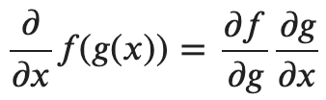
Chain Rule
The chain rule expressed with partial derivatives:
Instantaneous rate of change of g to x
Instantaneous rate of change of f to x
Instantaneous rate of change of f to g
Notes:
g -> a1
f -> a2

Slide 45
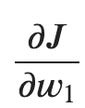
Applying the Chain Rule
x
w₀
a₁
w₁
a₂
Notes:
derivative of the loss with respect to the parameter w1: you already know how to do this

Slide 46
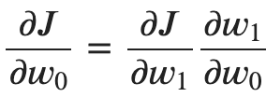
Applying the Chain Rule
x
w₀
a₁
w₁
a₂

Slide 47
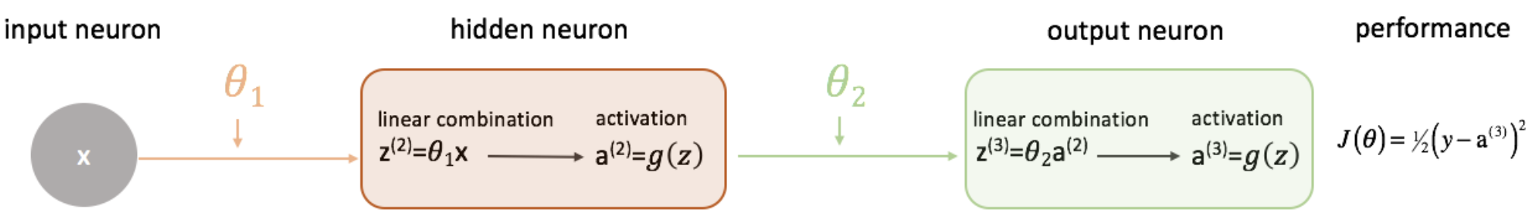
Adding Activation Functions
[source]

Slide 48
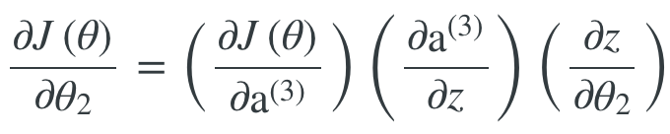
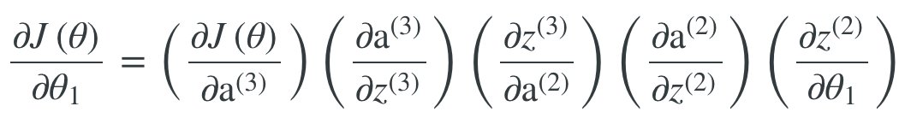
Adding Activation Functions
[source]

Slide 49
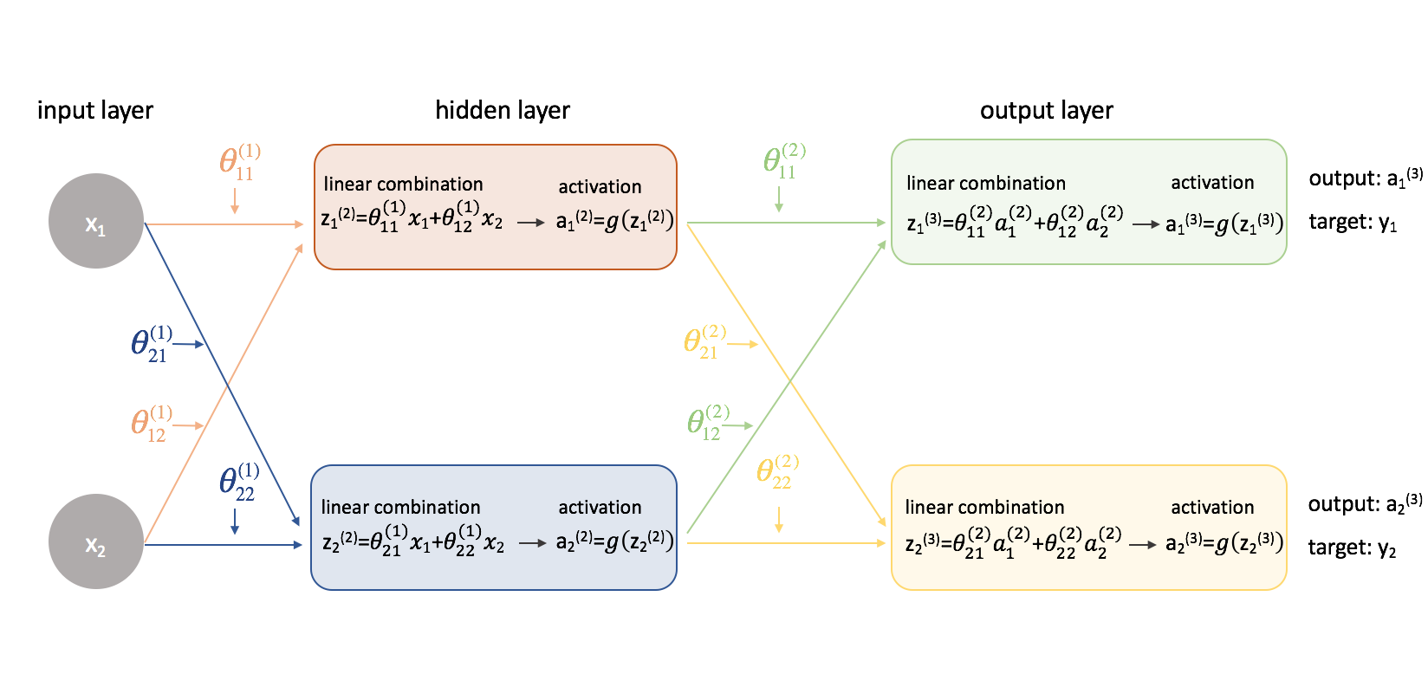
Adding Complexity
[source]

Slide 50
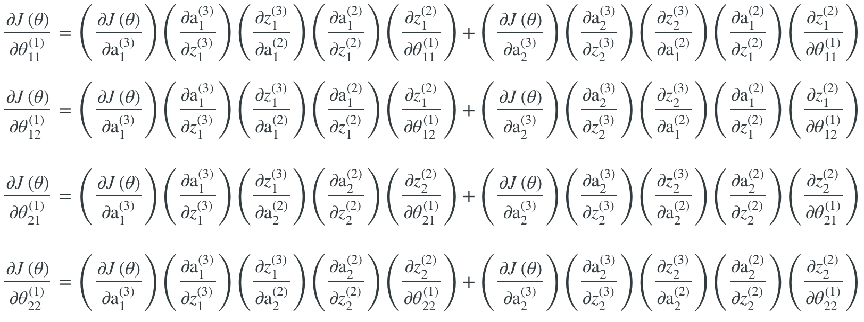
Adding Complexity
[source]
Notes:
sum of two terms
caching terms

Slide 51
Libraries with Automatic Differentiation
TensorFlow, PyTorch, etc.
User constructs a computation graph
System computes gradients
Updates parameters
And provides all kinds of tools
x₁
x₂
sin
*
+
σ

Slide 52
Back-Propagation II
Notes:
Q: [T/F] Back-propagation allows us to compute a partial derivative for all parameters using the chain rule.
A: T

Slide 53
Neural Network Details
Error
x₁
h₁
y₁
x₂
h₂
Prediction

Slide 54
Non-linear Functions
If f is a linear function and g is a linear function, then their composition f(g(x)) is a linear function
x
a₁
a₂
Notes:
Intuitively, a function is a transformation to the vector x. Applying a linear function preserves all the linear relationships between the vectors.

Slide 55
Non-linear Functions
If f is a linear function and g is a linear function, then their composition f(g(x)) is a linear function
x
a₁
a₂
Without non-linear activations, all neural network functions could be reduced to a single layer

Slide 56
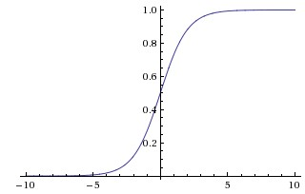
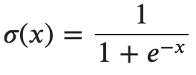
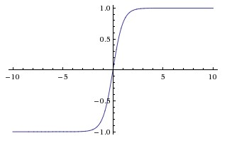
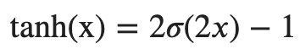
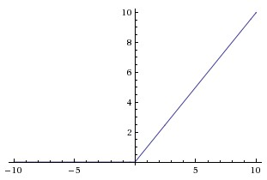
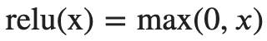
Non-linear Functions
Sigmoid
Tanh
ReLU

Slide 57

Optimizers
SGD
[source]

Slide 58
Optimizers
SGD
Learning Rate schedules

Slide 59
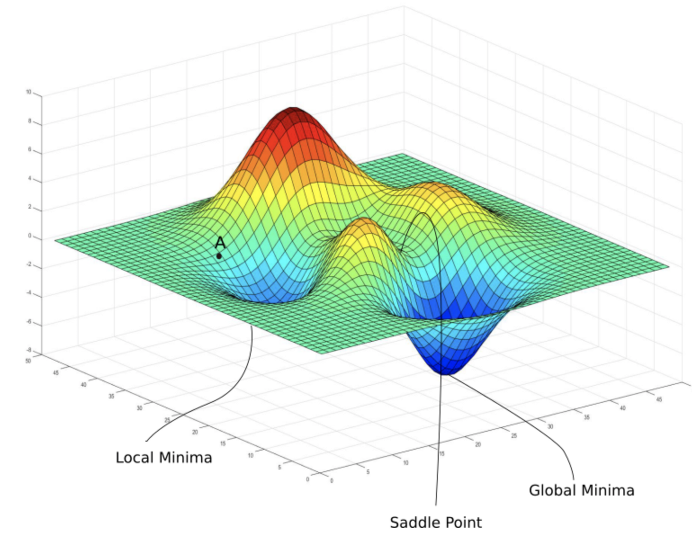
Optimizers
SGD
Learning Rate schedules
Momentum
[source]

Slide 60
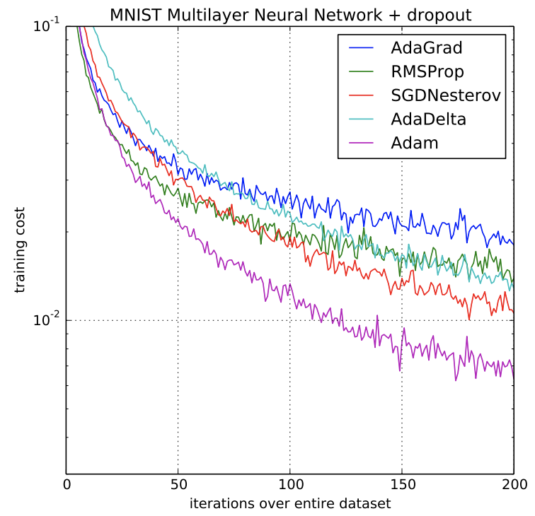
Optimizers
SGD
Learning Rate schedules
Momentum
Adagrad & Adam
[source]
Notes:
use different learning rate for each parameter

Slide 61
Optimizers
SGD
Learning Rate schedules
Momentum
Adagrad & Adam
Distributed optimizers

Slide 62
Neural Network Details
Notes:
Q: [T/F] Neural networks do not need non-linearities to learn non-linear functions.
A: F

Slide 63

Biological Inspiration
[source]

Slide 64
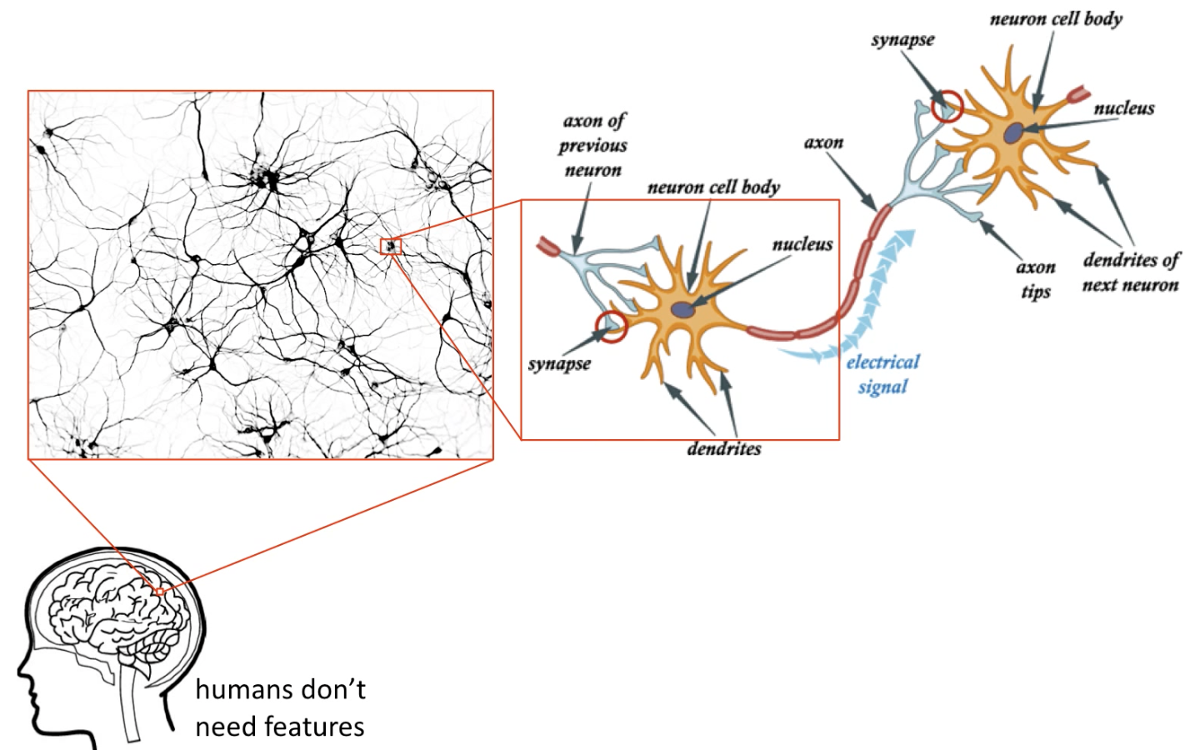
Biological Neural Networks
[source]

Slide 65
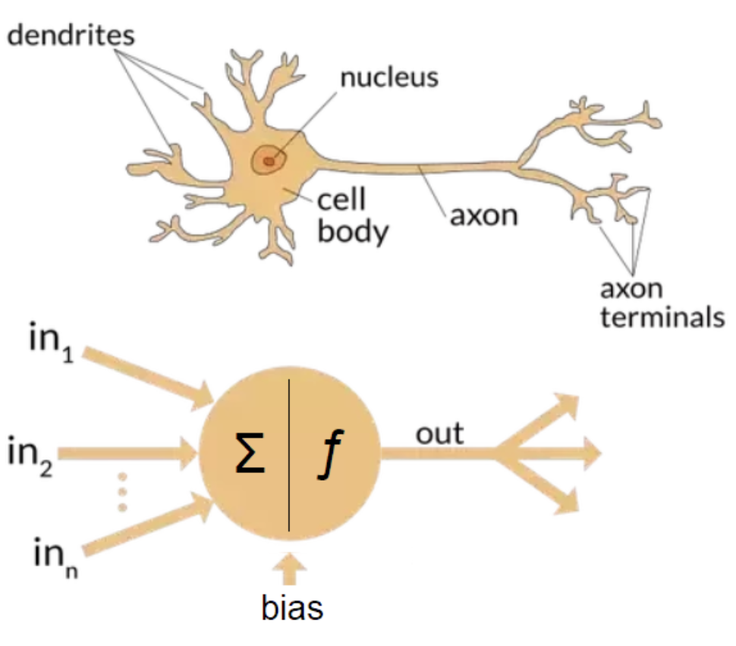
Biological vs. Artificial Neural Networks
Brains are:
Bigger (?)
~100 billion neurons
~100 trillion connections
Slower
Fire at most 200 times/sec
Delay between firings
More efficient
~20 watts
Minimal heat generation
Notes:
brains are also more flexible -- developing new connections up until around age 25
individual neurons adapt to new tasks
and remember that brains solve lots of problems at once, combining predictions from different specialized regions

Slide 66
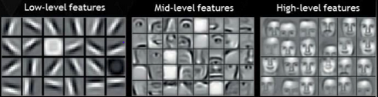
Hierarchical Structure in ANN Layers
Lower layers learn simple patterns
Higher layers learn complex patterns

Slide 67
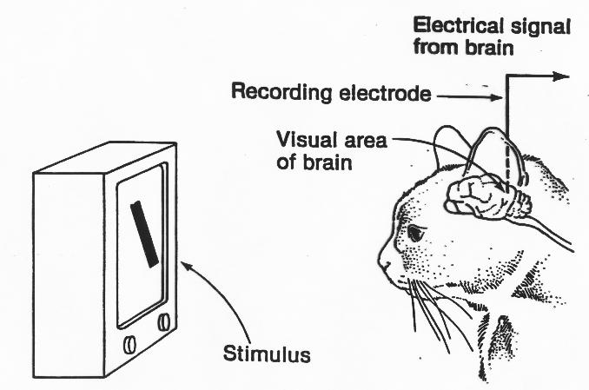
Hierarchical Structure in Brains
Hubel & Wiesel Cat Experiment (1959)
[source]
Notes:
used a paralyzed cat -- connect electrodes to pick up electrical activity (neuron firing) from the visual area of the brain
tried projecting all kinds of objects but nothing caused a big reaction
finally, by accident, the edge of the transparency sliding across the screen produced a big reaction
neurons responding to a diagonal line (even a faint one)
research has come a long way… can use special pigments to image activity of hundreds of individual neurons at once
neurons detecting basic lines and shapes can change within days or weeks

Slide 68
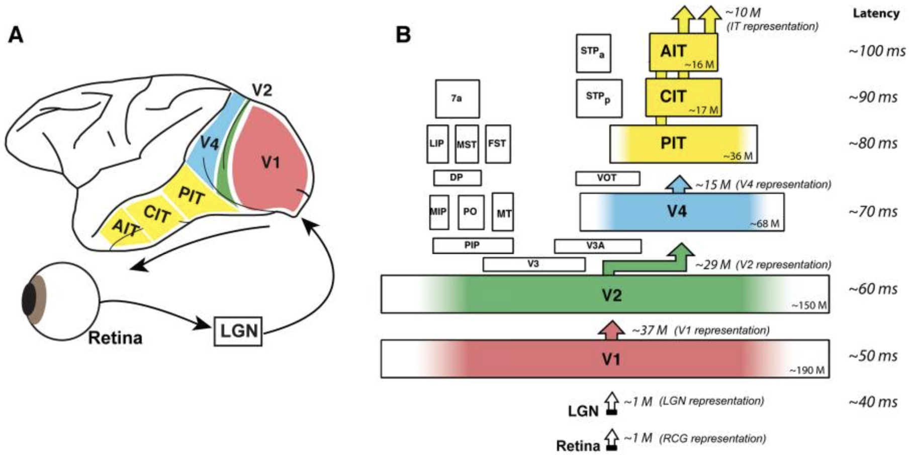
Hierarchical Structure in Brains
[source]
Notes:
“How does the brain solve visual object recognition” - 2012
diagram corresponds to a monkey brain
abstraction hierarchy
bottleneck shape matches common architecture in ANNs

Slide 69
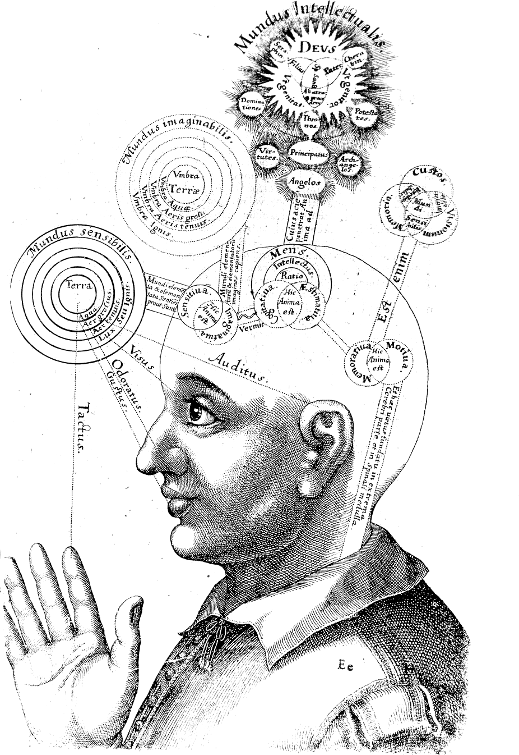
ANNs are not Brains
What are the limits in scaling up ANNs?
What kind of feedback is necessary for real understanding?
Is a body necessary?
What is consciousness and where does it come from?
[source]

Slide 70
Biological Inspiration
Notes:
Q: [T/F] Both ANNs and brains appear to arrange neurons in layers, with sensitivity to increasingly complex patterns
A: T

